Slide 1
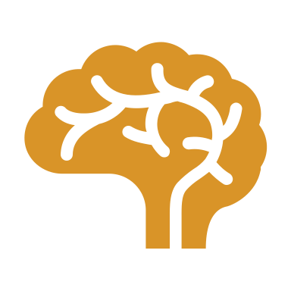
MIE1624
Group 19 Presentation
Qishu Deng
Zhixuan Mai
Luyuan Wang
Yan Cui
Yu Xia
Zhiqing Xu
Haoyu Shu

Slide 2
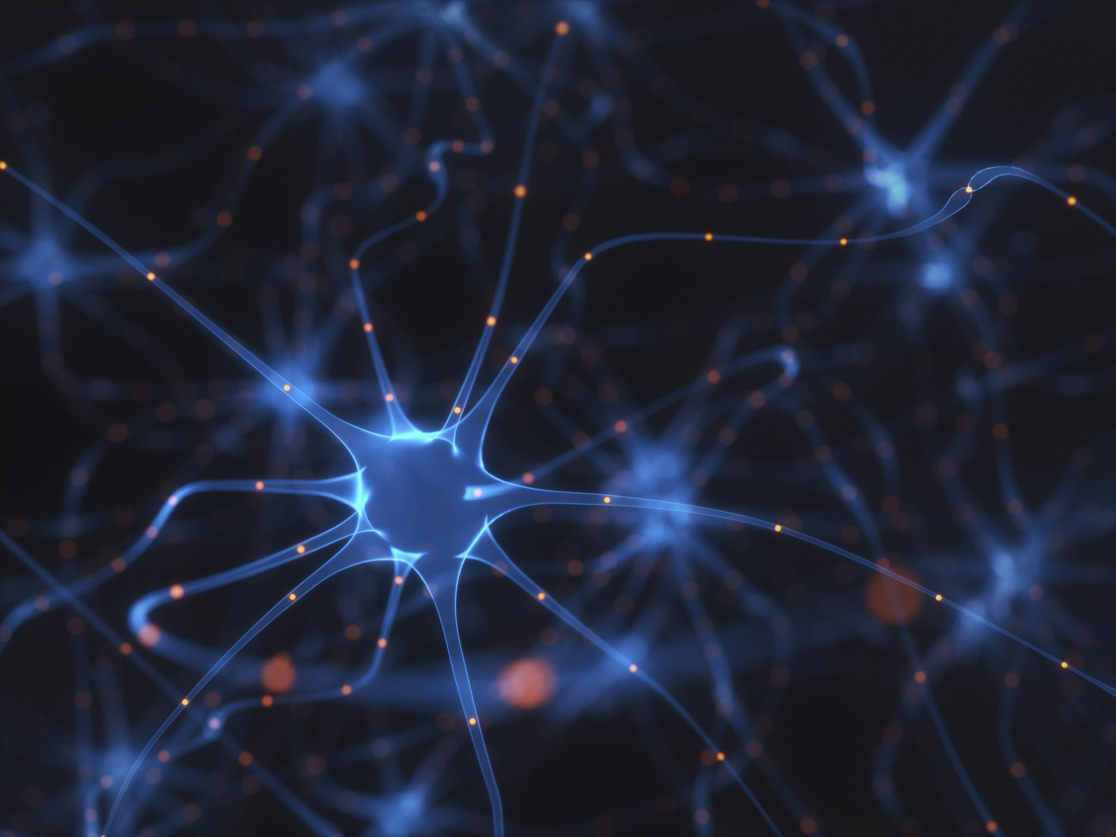
AGENDA
Artificial neural networks (ANNs) :
Autoencoder Neural Network
Generative Adversarial Networks

Slide 3
Artificial Neural Networks (ANNs)
Inspired by the structure and function of human brain
Consist of layers of ”neurons”
Apply in image classification, natural language processing, etc.
Notes:
Neural net algorithms, also known as artificial neural networks (ANNs), are a type of machine learning algorithm that are inspired by the structure and function of the human brain. They consist of layers of interconnected processing nodes or "neurons" that are designed to work together to solve a specific problem, such as image classification or natural language processing.

Slide 4
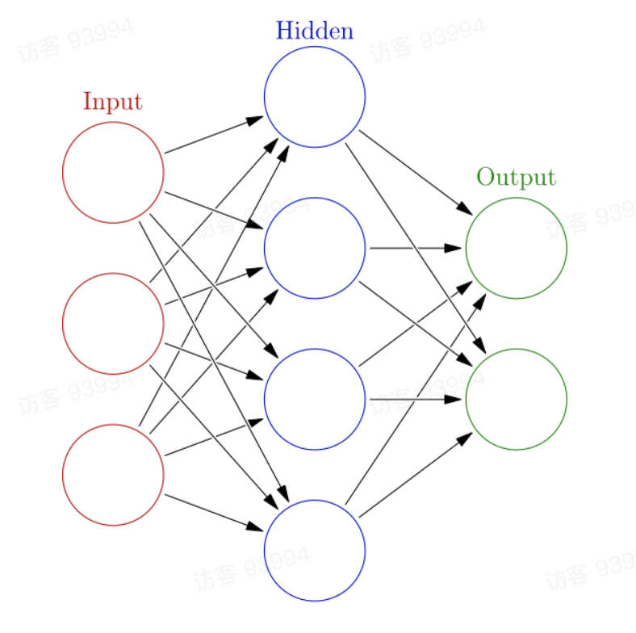
How does ANNS works?
Neurons can receive, process and send signal from connection (edges) to each other
The output of each neuron is computed by certain non-linear functions of the sum of its input
Both neurons and edges have weights to adjust the strength of signal
Neurons are organized into various of layers which may perform different transformations on their input
Common types include Autoencoder neural network and Generative adversarial network

Slide 5
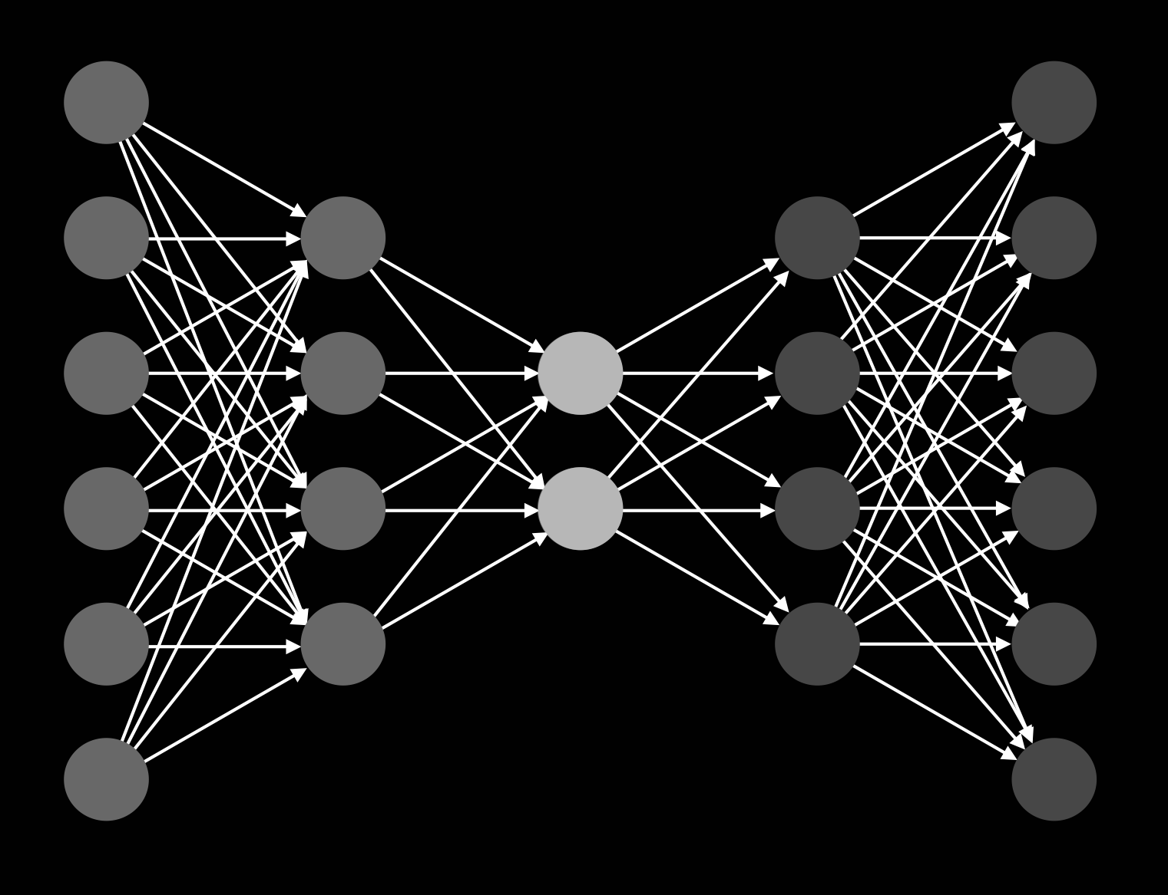
Autoencoder Neural Network
Commonly used for unsupervised learning tasks such as dimensionality reduction, data compression and anomaly detection
Basic idea is to learn a compressed representation of the input data by training the network to reconstruct the original data as closely as possible

Slide 6
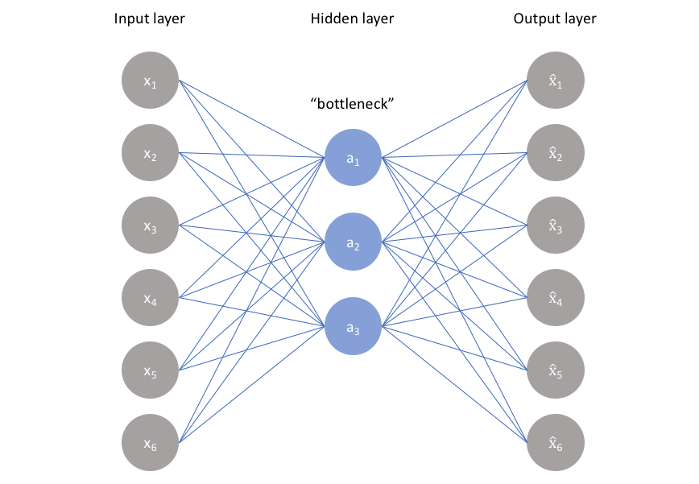
Architecture of Autoencoder
Encoder-transforms the input data
Decoder-recreates the input data from the encoded representation
Nonlinear dimensionality reduction
Hidden layer- “bottleneck”:
contains few nodes
constrains the amount of information and forces a learned compression of the input data
Without Bottleneck: learn to simply memorize the input values by passing data through out the network

Slide 7
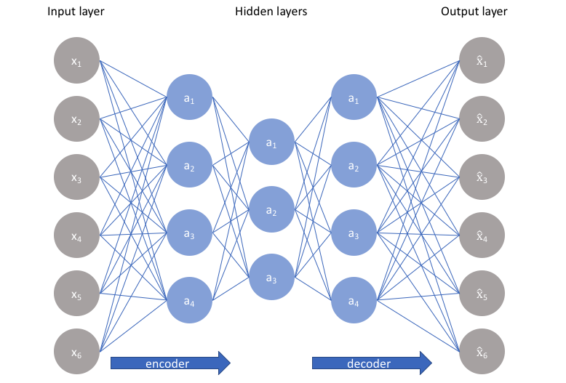
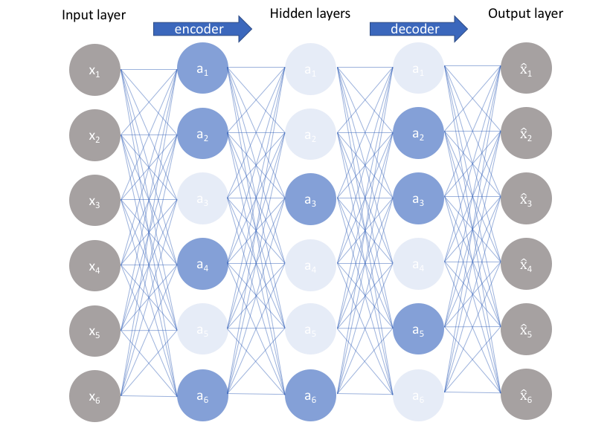
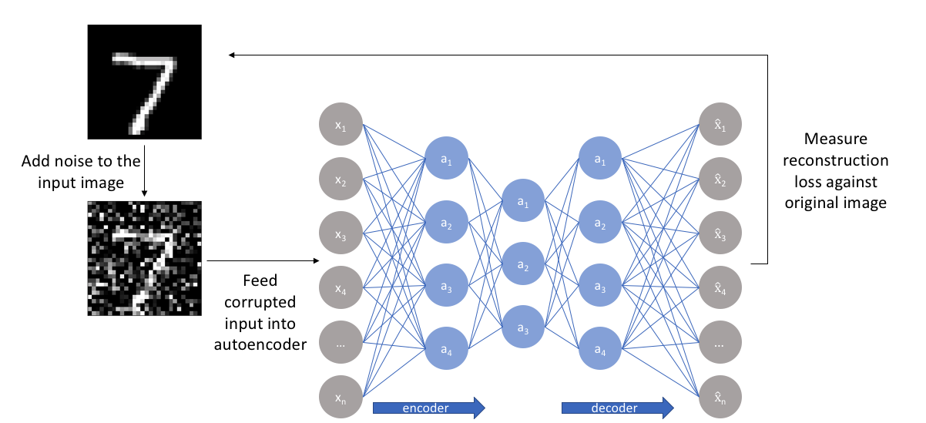
Classifications
Undercomplete Autoencoder
Sparse Autoencoder
Denoising Autoencoder

Slide 8
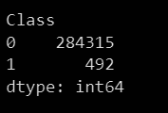
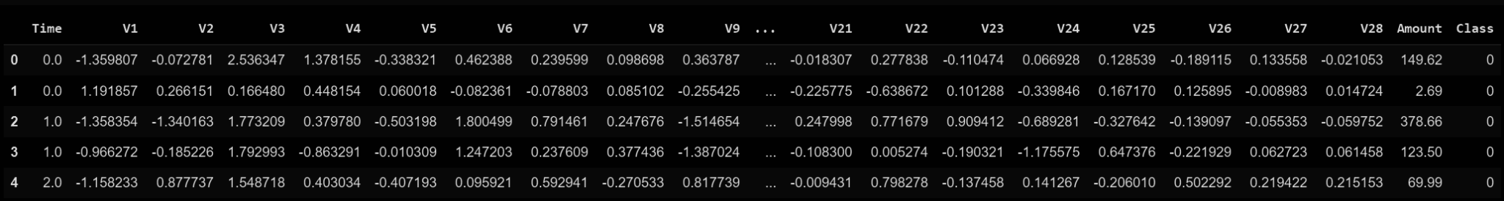
Applications
Logic behind fraud detection:
Autoencoders can learn patterns of large amount of data
fraudulent transactions often have distinctive features that differ from legitimate transactions
Dataset: https://www.kaggle.com/datasets/mlg-ulb/creditcardfraud
Pros:
Real-world data with a large amount (284807 rows of data)
Features are informative and pre-processed
Cons:
Anonymized data, hard to interpret
Highly unbalanced
Non fraud (label 0) : 284,315
Fraud (label 1): 492
Normalization is performed
Dataset sample is shown in the figure below,

Slide 9
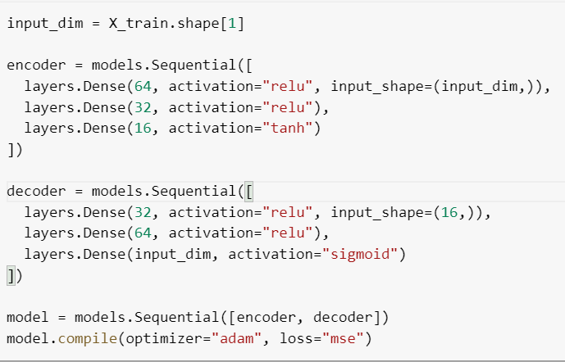
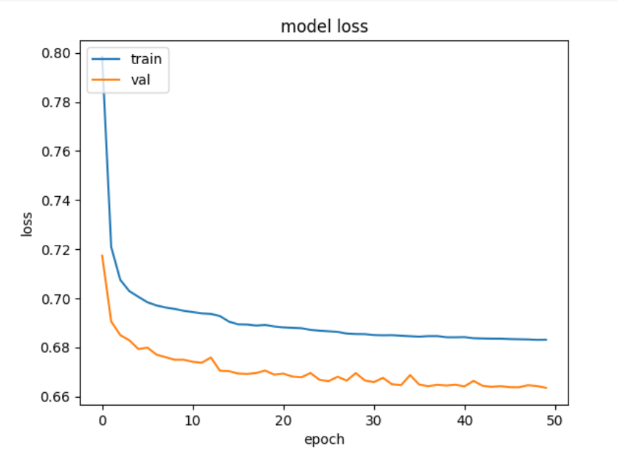
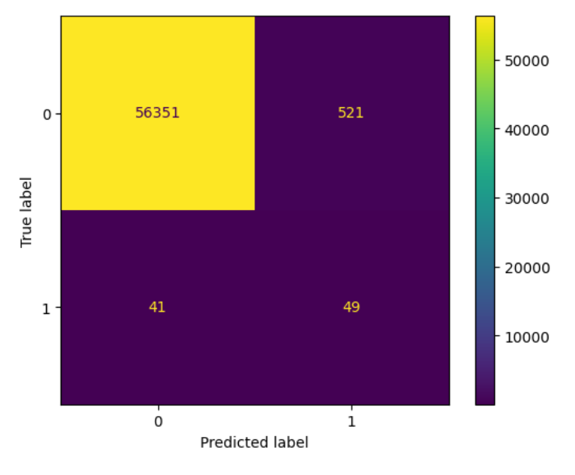
Applications
Autoencoder model:
3 full-connected layer for encoder and decoder
hyperbolic tangent activation function for encoder
sigmoid activation function for decoder
mean squared error as the loss function
train 50 epochs with 64 batch size
Evaluation:
Prediction with a threshold squared error (99th percentile)
Evaluate with confusion matrix
Model Definition
Result:
Precision : 0.08
Recall : 0.54
Accuracy : 0.99
ROC-AUC : 0.76
Reasons:
Simple model
Highly skewed class distribution
Training curve
Confusion Matrix

Slide 10
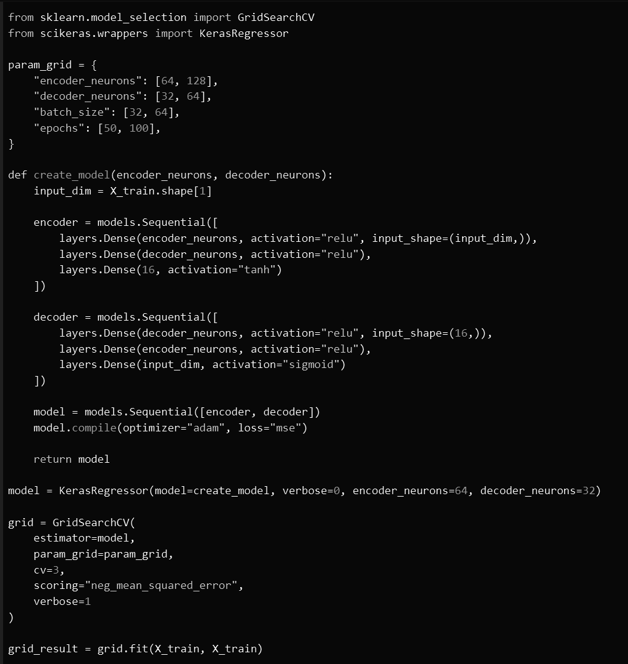
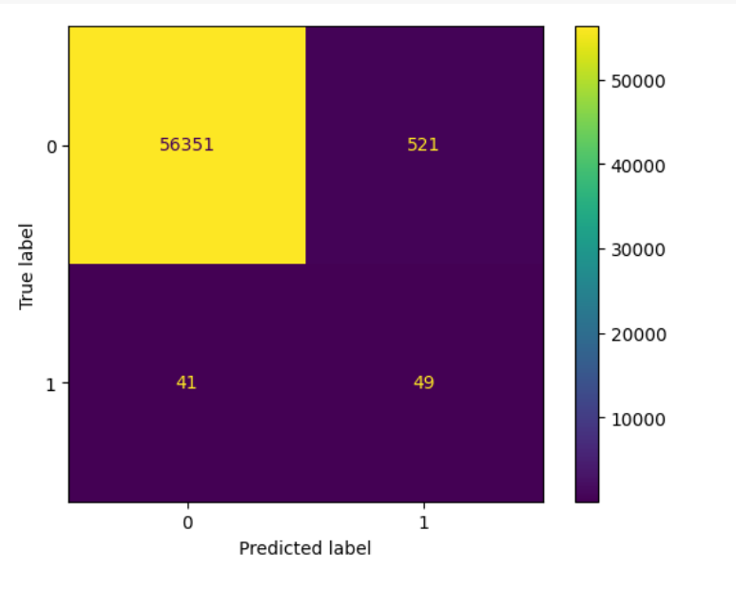
Applications
Hyperparameter tuning and cross validation:
Applicable for model performance on data regeneration
Parameters: encoder neuron, decoder neuron, batch_size, epoch
Cross validation: prevent overfit
Evaluate by the mean square error between reconstructed and original data
Best Parameters:
batch size: 32
epochs: 100
encoder neurons: 128
decoder neurons: 32
Epoch 50, batch size 64
encoder neurons 64
decoder neurons 32
Epoch 100, batch size 32
encoder neurons 128
decoder neurons 32

Slide 11
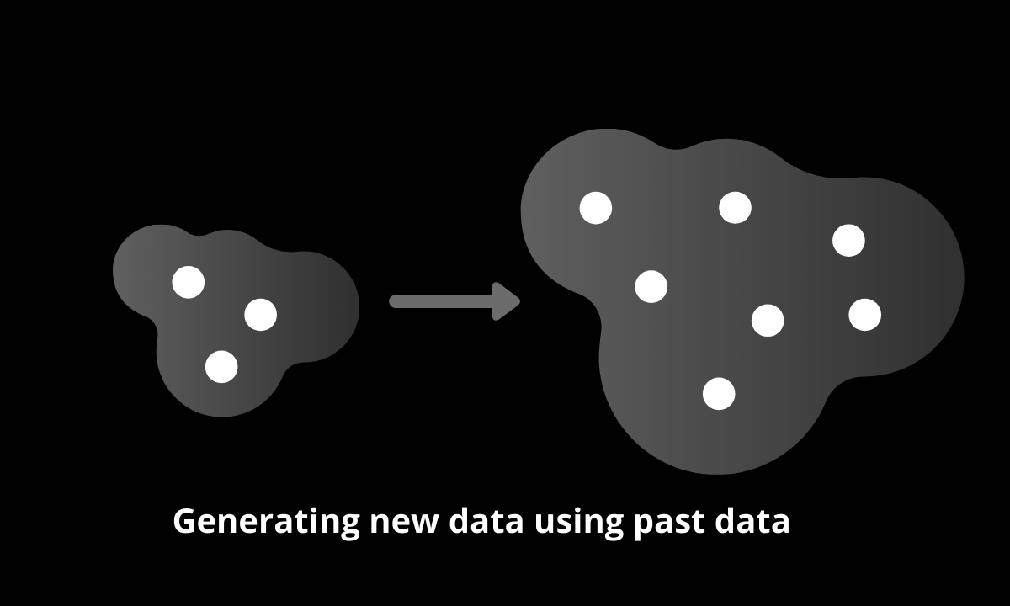
Generative Modeling is an Unsupervised Learning Task
Unsupervised learning algorithms work with unlabeled data to find patterns and relationships
Objective: learn the underlying probability distribution of the input data, which can be used to generate new data samples that are similar to the original dataset.
Applications: including image and text generation, speech synthesis, and data augmentation.

Slide 12
What is GAN?
GAN is a Common Generative Model
Comprehend the distribution of the training data and create new data samples from that same distribution
Applications：image generation, and data augmentation
GAN consists of two neural networks: a generator and a discriminator.

Slide 13
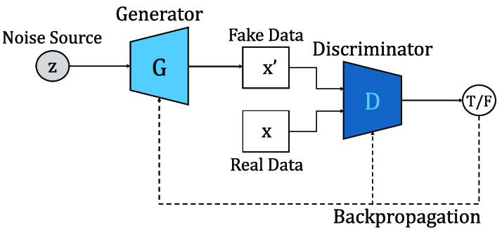
GENERATOR
Neural network that generates fake data and pass it to discriminator
Generator loss penalizes the generator for producing a sample that the discriminator network classifies as fake.

Slide 14
DISCRIMINATOR
Classifier that distinguishes real data and fake data (created by the generator).
Discriminator loss penalizes the discriminator for misclassifying a real instance as fake or a fake instance as real.

Slide 15
GAN FLOWCHART
At the beginning, the discriminator can recognize fake results from the generator instinctively
As training processes, the generator produces outputs that are more similar to real data which can reduce discriminator accuracy.

Slide 16
GAN Practical Example – Virtual Faces Generator
A deep convolutional generative adversarial network (DCGAN) is trained
Dataset: https://mmlab.ie.cuhk.edu.hk/projects/CelebA.html
Images from the dataset are 178 * 218 , and is adjusted to 128 * 128.
The model is trained on a single A100 GPU for 120 epoches.
It takes around 15 hours to finish the training.
The original DCGAN model is also trained, (takes only ~2 hours).

Slide 17
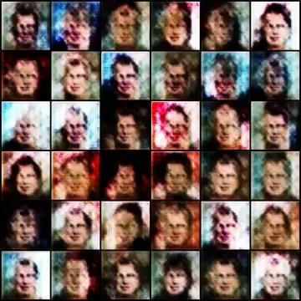
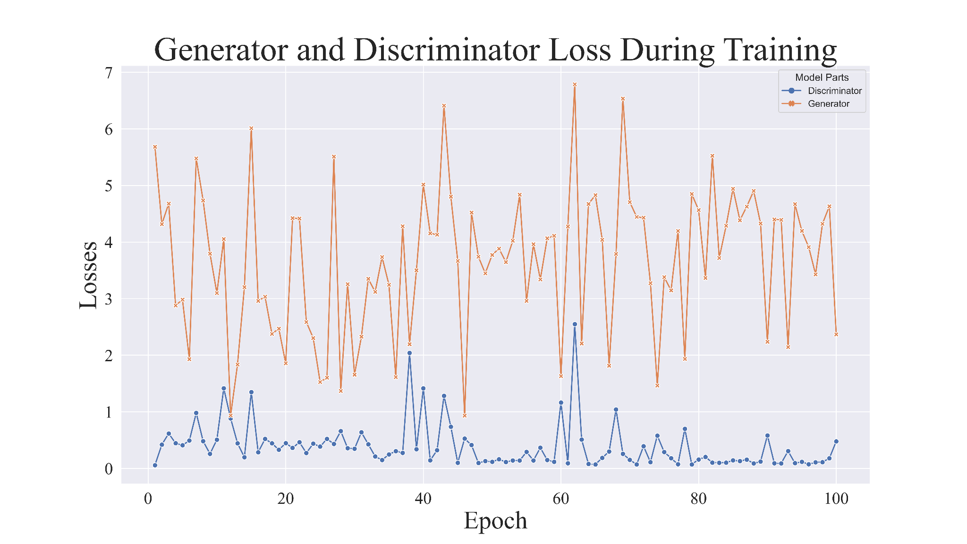
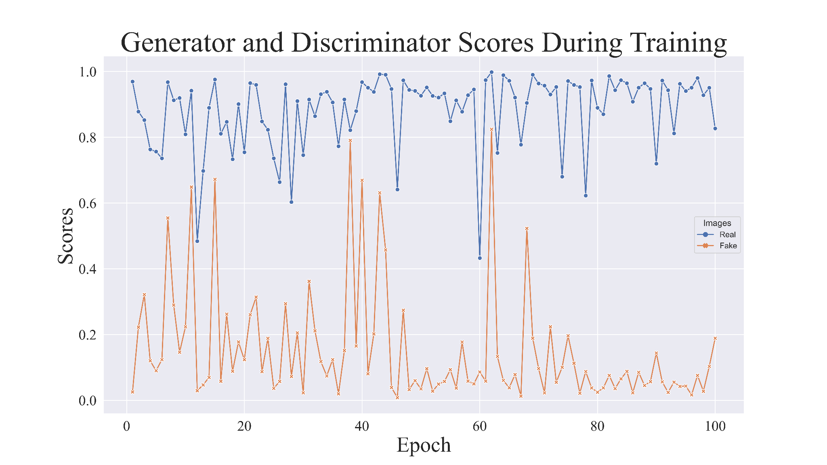
GAN Practical Example – Outputs of DCGAN

Slide 18
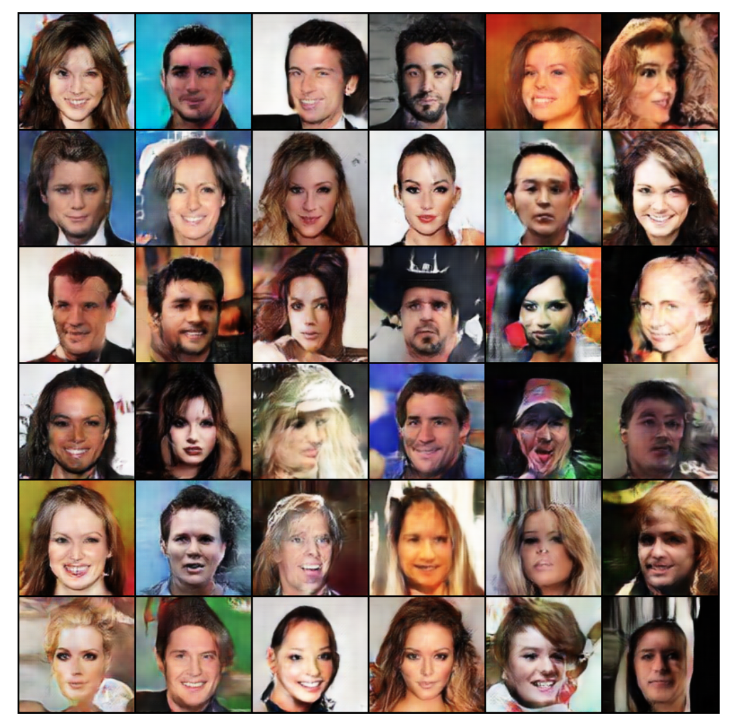
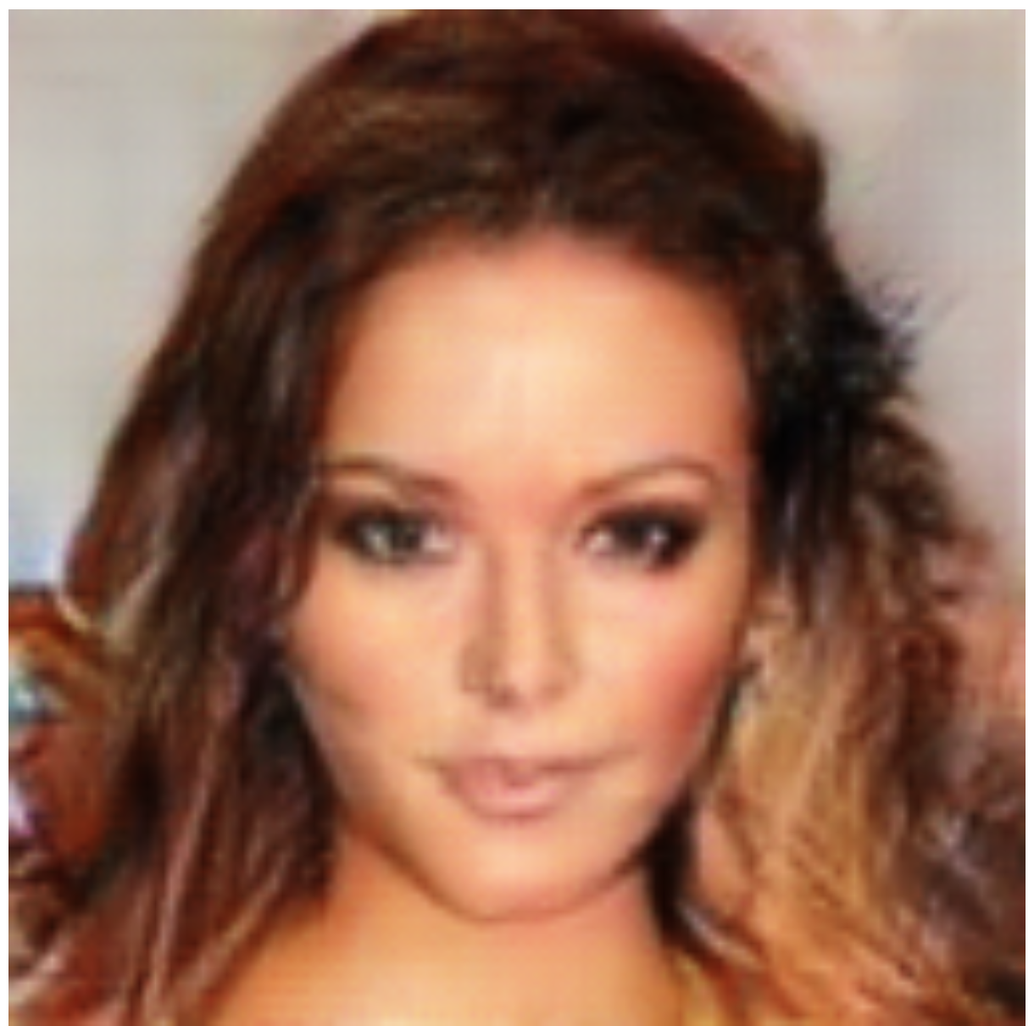
Enhanced DCGAN performance
(128 x 128 Image Generator)
Output generated from 36 random latent space inputs:
Example of good output:

Slide 19
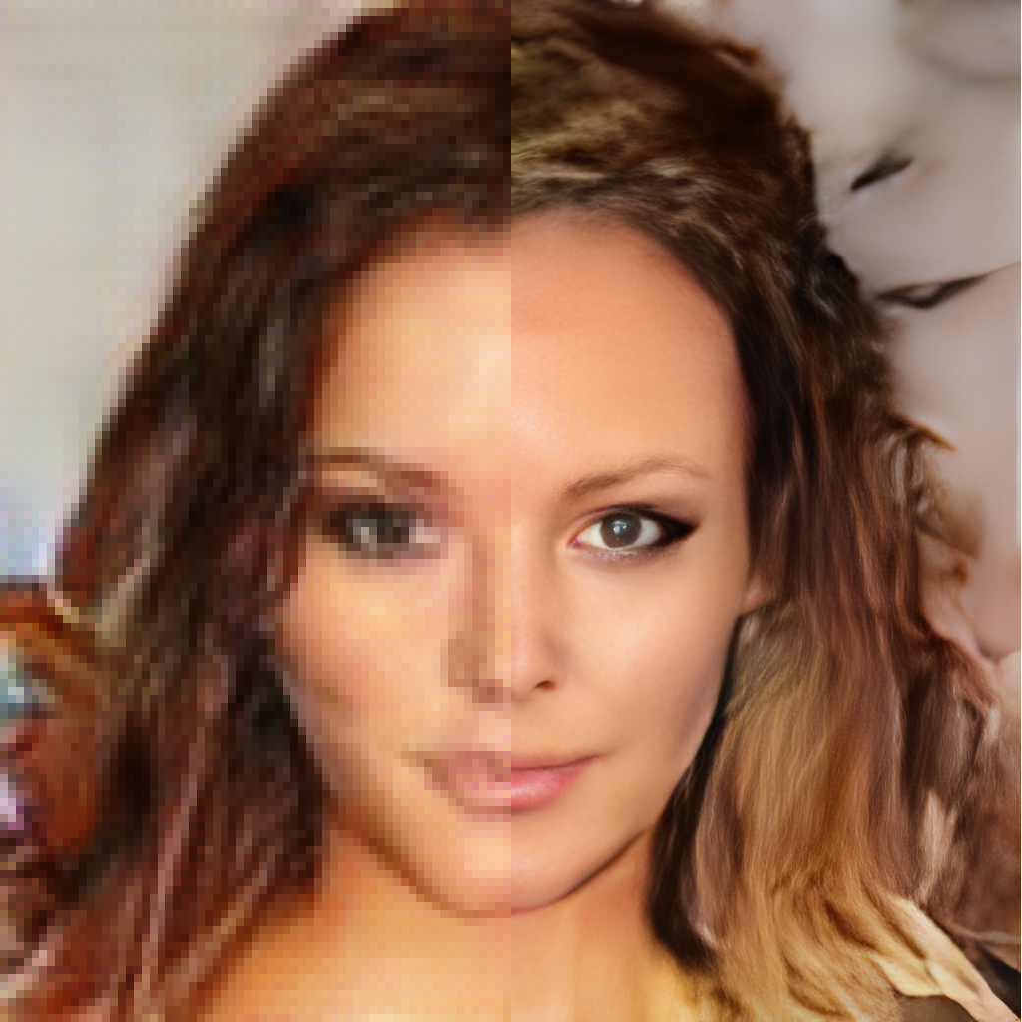
SRGAN - Super Resolution GAN
Upscaling Image Resolution.
A trained DCGAN (using Train_Enhanced_DCGAN.ipynb) is loaded to generate low-resolution images.
A SRGAN model trained by others is used to scale-up the resolution of the generate images.
The figure below shows a comparison between a generated 128 * 128 image (using the model we trained) and the result of upscaling.

Slide 20
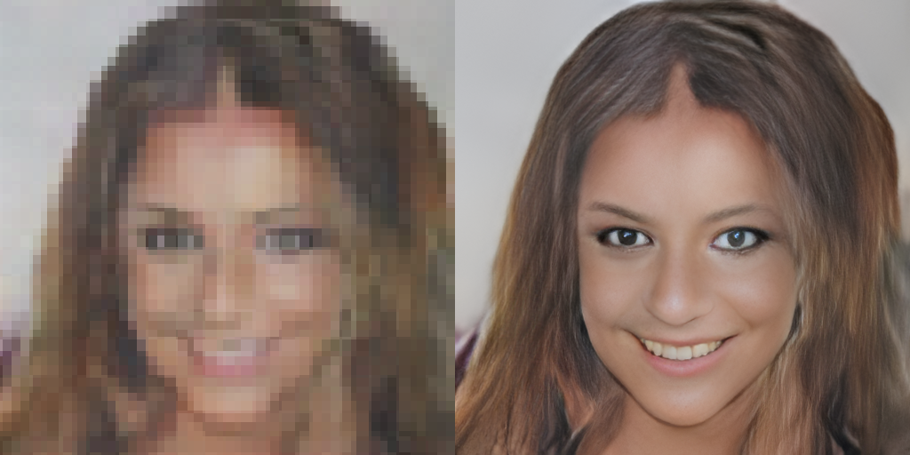
SRGAN - Upscaling Image Size
Example of upscaling 64 *64 image using a pretrained SRGAN.

Slide 21
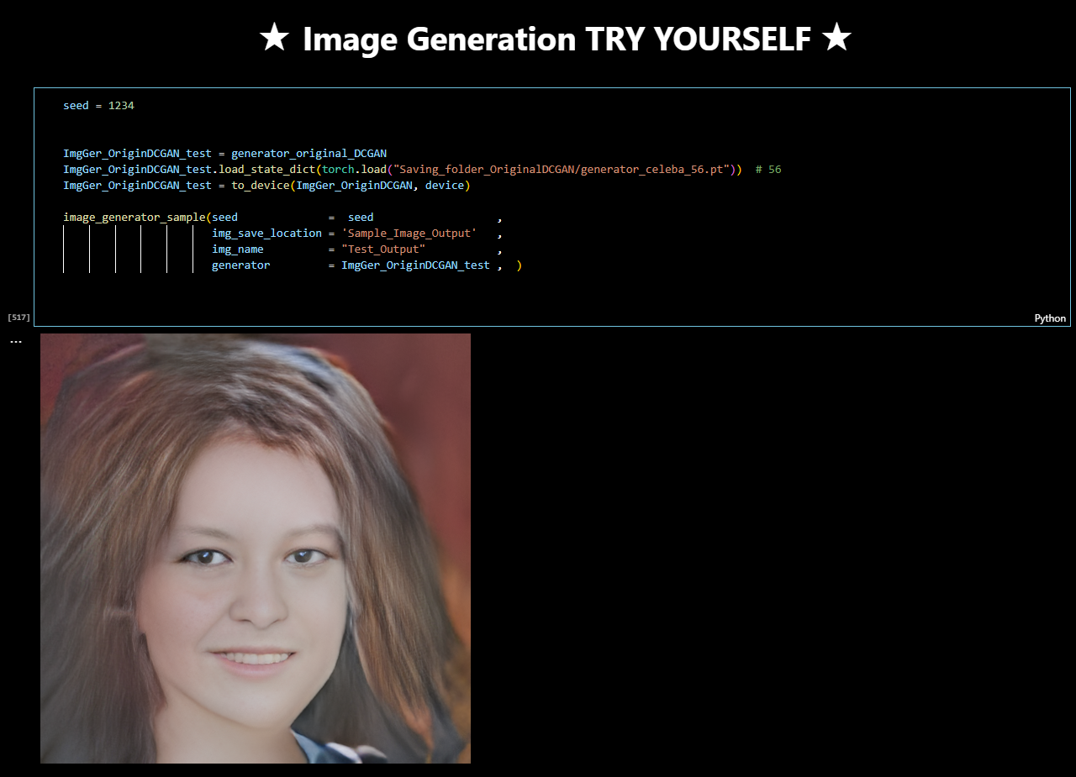
https://github.com/Zhiqing-Xu/Basic_GAN/blob/main/Run_Image_Generator_Main.ipynb
Virtual Faces Generator
https://github.com/Zhiqing-Xu/Basic_GAN/blob/main/Run_Image_Generator_Main.ipynb

